Slide 1

OHIO EXPORT GAP ANALYZING PLATFORM
-SHIFAN ABRAR RASHID

Slide 2
OUTLINE:
Exploring the Datasets
Ohio’s Export Gaps & Export Potential
Automating the process
My Tech Stack
Summary

Slide 3
Exploring the Datasets
U.S. Census:
US Trade data by product/country
National export and import data by HS codes
Useful to track Long term growth patterns (throughout the years)
UN Comtrade:
International Demands & Market Potential
Global imports/exports for any country,
Rapidly updates so it’s ideal for AI-driven alerts
OECD:
Economic stats like GDP, inflation, trade. A variety of data classified into different groups
Export/Import data by product group
Ohio Export Report:
Finding Key industries in Ohio
State Level Export Performance
Key insights through visualizations

Slide 4
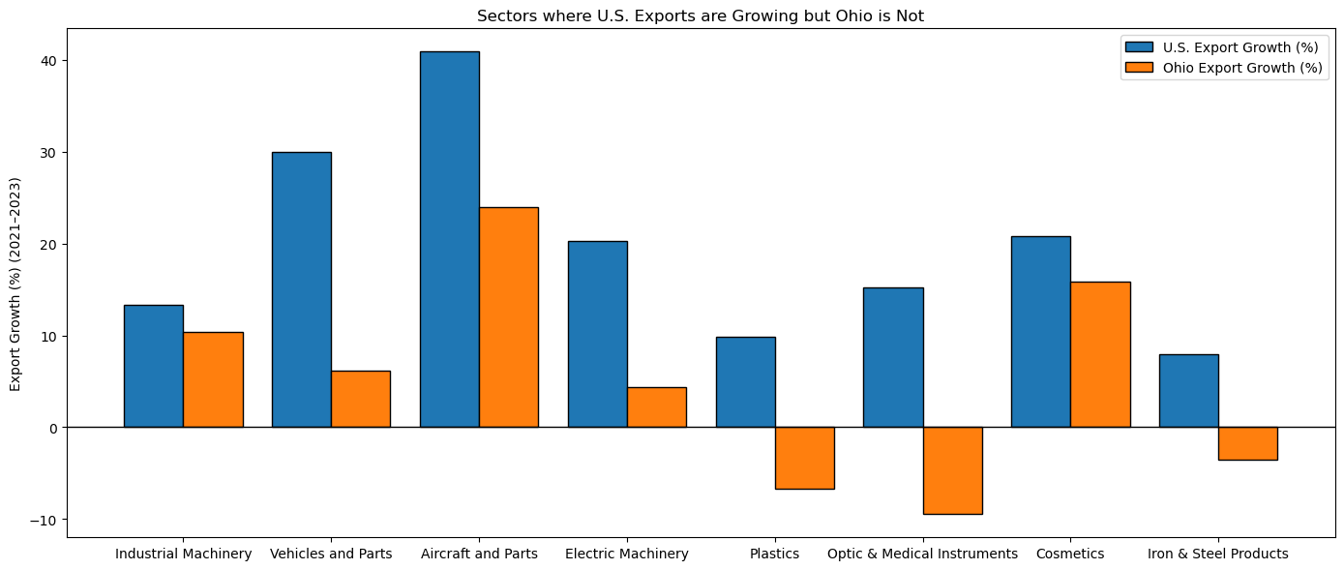
Sectors where U.S. Exports are Growing but Ohio is Not
Ohio is underperforming in several key sectors compared to national export growth, as shown by the widening gap between U.S. and Ohio export trends from 2021–2023.
Closing these gaps presents a major opportunity: aligning Ohio’s growth with U.S. averages could translate into billions in additional exports.

Slide 5
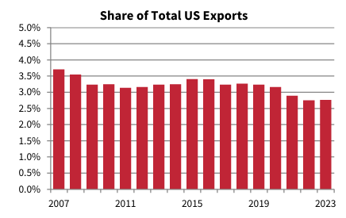
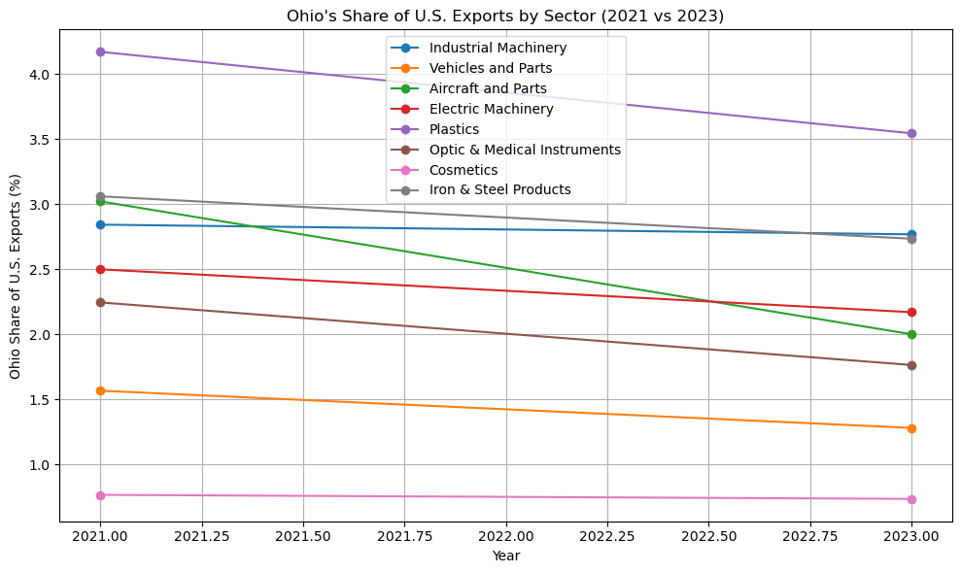
Ohio’s Share of U.S. Exports by Sector Over Time
There are some indication of erosion of Ohio’s competitive position in U.S. exports, especially in high-value manufacturing sectors.
Reversing this decline requires targeted strategies to expand Ohio’s presence in high-growth sectors and markets.

Slide 6
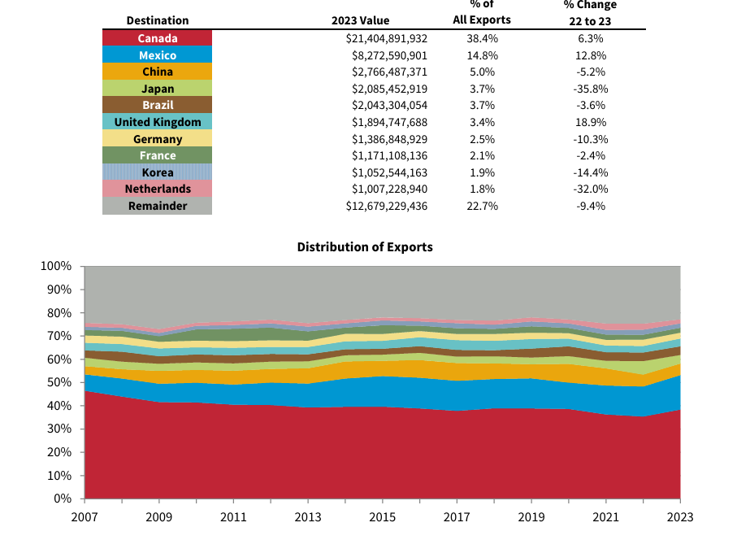
Ohio Exports are Heavily Reliant on Canada & Mexico
Exports to countries like Japan, Germany, Korea, Netherlands have been decreasing
This dependence increases exposure to economic and policy fluctuations in these markets, which could disrupt Ohio’s export performance.
A broader market presence would make Ohio’s export base more resilient, especially during regional economic downturns or trade disruptions.

Slide 7
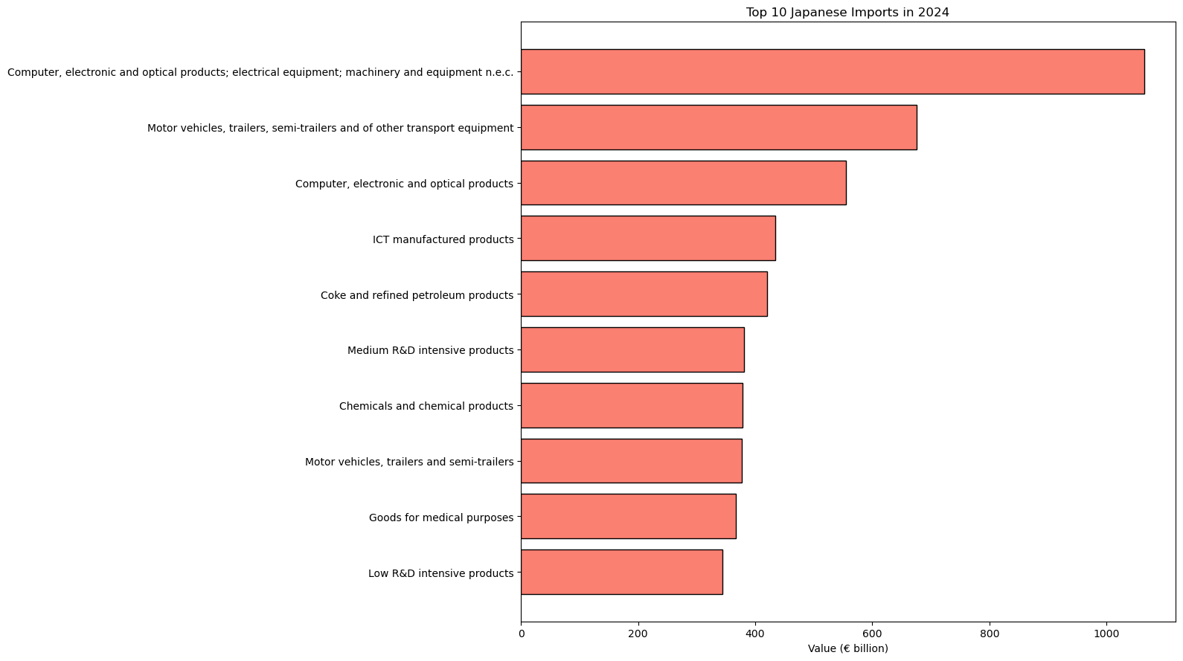
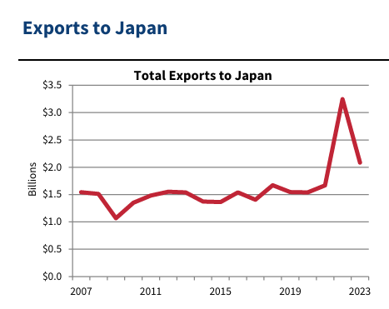
Excelling But Not Exporting
Japan’s import demand for key sectors remains strong, particularly in products where Ohio has competitive strengths such as industrial machinery, vehicles, electrical equipment, and medical instruments.
This gap highlights the need for targeted strategies to capture growth in advanced economies, where demand for Ohio’s core products is rising.

Slide 8
Ohio’s Export Gaps & Export Potential
Ohio ranks as the 10th largest exporting state in the U.S. (2023), demonstrating its strong position in national trade.
Ten countries each received over $1 billion in Ohio exports, reflecting significant global reach
Opportunities remain for additional export growth, as gaps persist in certain sectors and markets.
Targeted improvements can be achieved by focusing on sectors where U.S. exports are growing but Ohio is lagging, helping the state close performance gaps.
Heavy reliance on Canada and Mexico introduces trade risks; diversifying export destinations will enhance market stability and resilience.
High-potential markets such as Japan, Korea, and Germany present strong demand for products that Ohio specializes in producing but is currently under-exporting.

Slide 9
Automating the process
Generating Insights from Different Data Sources
Finding Sectors with High Potential and Possibility for Growth
Identifying Declining Sectors/Sectors not keeping up
Identifying Regional Demands & Export Potential
Real Time Insights & Alerts using API’s
Real Time Communication with Clients

Slide 10
Using AI to Automate this Process
Data Collection through APIs
Data Storage
AI for Data Cleaning
Automated Analysis & Insights
End-to-End AI Platforms
LangChain + OpenAI GPT → AI agent that calls OECD, UN Comtrade, and Census APIs
Relational Database:
MySQL
Cloud Data Warehouse:
BigQuery
GPT-4 or fine-tuned LLMs for text classification & mapping
Prophet for time-series forecasting
LangChain connects data pipelines, AI analytics, and dashboards

Slide 11

Step 1: Data Collection
Automatically Pull Data from API’s: U.S. Census API, UN Comtrade API, OECD BTiGE API
Tools like LangChain lets you connect LLMs to APIs & schedule API calls

Slide 12

Step 2: Data Cleaning & Integration
Once the data is collected it is stored in a data lake or database
AI Agents will need an ETL pipeline (via LangChain) to access this data for cleaning
Standardize the Format of the Data: HS code or NAICS code, Date Formats, Currencies, Units etc.
AI can flag inconsistent data & abnormal values
API → Raw Data Storage → AI Cleaning Layer → Clean Database → Insights & Dashboards

Slide 13

Step 3: Analysis & Forecasting
LangChain agents queries the database and the pipeline sends the data to Prophet
Prophet is a real time forecasting tool developed by Meta
It automatically detects trends, seasonality, and holiday effects etc
The user can gets real time insights through LLM’s

Slide 14
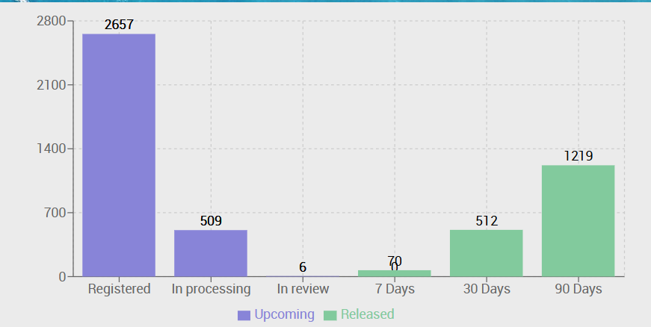
UN Comtrade API for Real Time Data
Frequent data refreshes (daily, weekly, and quarterly) ensure the platform remains current and responsive to market changes.
Real-time insights from UN Comtrade can power dynamic dashboards and automated client reports, enhancing decision-making and engagement.

Slide 15
How this can translate to Small Business Development
Small Businesses get easily understandable insights instead of Raw Data
Shows new export markets they may not be targeting
Provide Demand Data for Products in the Global Market
Businesses can benchmark themselves against National Growth Rate
Real time Insights & Alerts will provide early warning for risks or opportunities
Communicate Directly with Clients through the Platform
OECD/UN Comtrade/US Census API
AI Powered Analysis
Custom Business Reports & Alerts
New Markets & Increased Revenue

Slide 16
My Tech Stack
Languages: Python, R, SQL, JavaScript, React
Libraries: Pandas, NumPy, Matplotlib, Seaborn, Scikit-learn
APIs: OECD, UN Comtrade, U.S. Census APIs, etc
Tools: Tableau, PowerBI, MySQL, Git, Jupyter, LangChain (ETL)
Cloud: AWS/Azure

Slide 17
Summary
Ohio is a strong exporter but there are some clear trade gaps
Global Demand is rising in markets where Ohio is underrepresented
We can use U.S. Census Data, UN Comtrade, OECD BTiGE for national level, international level & product level data respectively
The Goal of the Project is to Automate this Process by leveraging AI
This can provide real time insights in Global Trade & can also benefit small businesses

Slide 18
DATASETS USED FOR THE PROJECT
Ohio Development Services Agency. (2024). Ohio Export Report.
OECD (2025), Bilateral Trade in Goods by End-use (BTiGE): Conversion key from Harmonised System to end-use: U.S. National Export Data, Japan Import Data, Korea Import Data
UN Comtrade. (2025). UN Comtrade Database [Data set]. United Nations Statistics Division. https://comtrade.un.org/

